Slide 1


Team Details
  Team name: localhost8000
  Team leader name: Anduri Roshan
  Problem Statement: Sustainability & Social Impact. Letting anyone ask their own neighbourhood about the hazards around it, rain and flooding, heat stress, wind, earthquake shaking and air quality, and get an answer they can trust, built on the public data and official maps that agencies already publish.

Slide 2
Brief about the idea
Before It Hits lets you hold a conversation with your own neighbourhood. Not only about storms: where rainwater will collect on your street, how hard the heat will sit on it, which way the wind will blow, how the ground would shake, how clean the air is, and which roads go under first.
Meteorological agencies and disaster authorities already do this well at the regional and city scale, and their forecasts and official flood maps are the authoritative sources this product builds on and checks itself against. Before It Hits adds the last step: it takes that public data (terrain, roads, population, live weather) and turns it into a block-level screening that anyone can open and read, then ask follow-up questions about in plain language.
Its defining choice: no language model ever invents a number. A deterministic engine computes every figure; the Gemini agents only interpret the question and explain the result. A verifier agent checks that every number traces back to the engine, and the product openly refuses what it cannot honestly claim, such as exact depths, timing, casualties or dispatch.
Useful to a resident and to a city team alike, and to other software agents through the same verified interface.

Slide 3
Opportunities
Who it is for
• Anyone: a resident checking their own street, a parent deciding a school run, a shop owner, a volunteer.
• City teams, NGOs and other software agents use the very same verified interface. The goal is easier access for everyone, not a replacement for anybody.
How it is different
• A regional forecast tells you how much rain will fall, or how hot it will get. This tells you what that does street by street, across five hazards, in one place.
• Official flood maps are authoritative but are published for planning. This runs live against today's forecast, and is checked against those maps where they exist.
• Block-level, deterministic, explained in plain language, and explicit about its own limits.
How it solves the problem, and the USP
• Turns data a city already publishes into something a non-expert can act on, with no new sensors.
• “No model ever produces a figure”, enforced in code by a deterministic engine plus a verifier agent.
• Two-tier honesty: screening anywhere, validated against the official government flood map in Kochi. It refuses the unknowable instead of guessing.

Slide 4
List of features offered by the solution
• Flood pooling screening: ranks where rainwater collects (1 to 5) over public terrain data.
• Forecast time bar: watch the low spots fill and roads go under as the rain accumulates.
• Plain-language questions: ask “will my street flood tonight?” and get a checked answer.
• Population exposure: roughly how many people are in the worst spots (GHS-POP).
• Live rainfall forecast (Google Weather API), animated across the next 24 hours.
• Heat (Google Weather plus Landsat surface heat) and air quality (Google Air Quality API).
• Honest answers: a verifier rejects any unsupported number, and any hedging odds word.
• Preparations within budget: a costed, ranked list for whoever is doing the planning.
• Event-driven Watcher: publishes preparation alerts to Pub/Sub on a schedule.
• Compare against the government's official flood map (validated tier, Kochi).
• Agent interoperability: an MCP server (/mcp) and an A2A agent (/a2a) over the same engine.
• Earthquake shaking exposure, and local news context (GDELT).

Slide 5
Process flow diagram
Request pipeline: every figure comes from the engine, never the model
User
question
A1
Coordinator
A2 Scenario
question to params
A3 Forecast
Weather API
A4 Engine
fill and route
computes figures
A6 Narrator
explains only
A7 Verifier
traces every number,
else refuses
Answer
Event-driven path, on a schedule, in parallel
Cloud Scheduler
every 30 min
Watcher
sweeps preset areas
Pub/Sub
bih-alerts topic
Alerts banner
anyone can read it
No language model ever produces a number.
The engine computes every figure. A7 Verifier refuses any claim it cannot trace back to the engine, and the product refuses water depths, timing, casualties and dispatch outright.

Slide 6
Architecture diagram of the proposed solution
Client: static web app in the browser
Google Maps JS · panel tabs: Agent, Rain, Details, Heat, Air, News · preparation-alerts banner · forecast time bar
Google Cloud Run: FastAPI service (asia-south1, min-instances 1, 2 vCPU / 2 GiB, built by Cloud Build)
/api/analyse
screening
/api/ask
plain-language Q&A
/api/forecast
rain, heat, air
/api/watch
and /api/alerts
/mcp
MCP server
/a2a
A2A agent card
Agent pipeline: Gemini 3.5-flash writes, 3.8-flash checks. The models explain; they never compute.
A1 Coordinator
routes the ask
A2 Scenario
question to params
A3 Forecast
Google Weather API
A6 Narrator
explains, no numbers
A7 Verifier
every figure must trace
Deterministic terrain engine (rasterio + numba). Produces EVERY figure.
despike DEM → fill and route → rank low spots 1 to 5 → rain-to-fill per spot → roads overlay → population exposure → comparison with the official flood map
Open data, baked into the container image
DeltaDTM (DEM) · OpenStreetMap · GHS-POP · KSDMA official flood maps (Kochi) · Landsat
Google APIs, live
Weather · Air Quality · Maps Platform
Event-driven and delivery: Cloud Scheduler → /api/watch → Watcher → Pub/Sub (bih-alerts) → /api/alerts → alerts banner | Cloud Build → Cloud Run

Slide 7
Technologies used in the solution
Google Cloud and AI
• Cloud Run, Cloud Build, Pub/Sub, Cloud Scheduler, Vertex AI (optional), Gemini
• Google Weather API, Google Air Quality API, Google Maps Platform
Engine and backend
• Python, FastAPI, Uvicorn, rasterio, numba, pyogrio, shapely
Agent interoperability
• Model Context Protocol (MCP), Agent2Agent (A2A), both hand-rolled over JSON-RPC 2.0
Open data
• DeltaDTM (DEM), OpenStreetMap, GHS-POP, KSDMA flood maps, Landsat, GDELT news index

Slide 8
Estimated implementation cost
Runs on Google Cloud pay-as-you-go: Cloud Run (one always-on instance), Cloud Build, Pub/Sub, Cloud Scheduler, plus metered Google APIs (Weather, Air Quality, Maps).
Staged region data (about 39 MB) is baked into the container image, so there is no storage or egress in the request path.
For a single city this is on the order of a few US dollars per month. API cost falls to near zero when idle, with one warm instance kept so a live demo stays responsive.

Slide 9
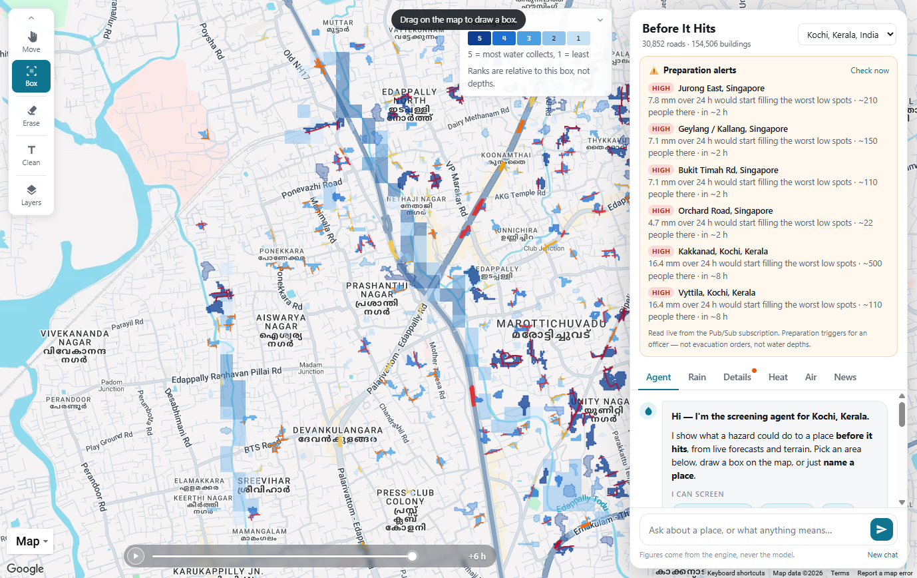
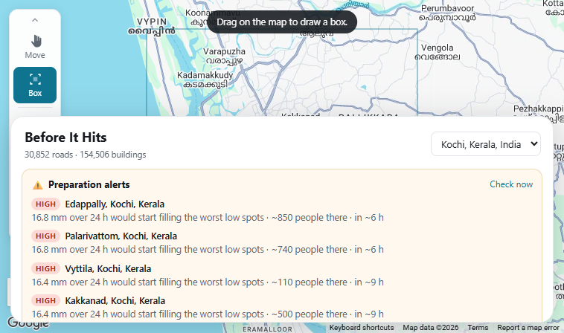
Snapshots of the prototype
Forecast time bar: the low spots fill and roads go under as rain accumulates
Event-driven preparation alerts, published to and read back from Pub/Sub

Slide 10
Prototype Performance report/Benchmarking
610 tests, all green
568 test functions across 33 files, expanding to 610 collected cases. All offline and deterministic: synthetic terrain with known answers, recorded provider fixtures, no network or model call in the suite. Counts below are functions.
• Agent and honesty layer, about 240: question routing and refusals (72), multi-turn chat and named places (69), the pipeline and verifier (53), the MCP and A2A surface (20).
• Terrain engine, about 67: fill-and-route hydrology on known DEMs (9), end-to-end screening (13), DEM despiking (6), road overlay (16), official flood-map comparison (10), 2024 Kochi storm replay (9).
• Live-data adapters, about 59: forecast window and wettest-24h pick (29), weather grid (14), wind (12), observed rain gauges (4).
• Other hazards, about 115: traffic-study bounds (35), earthquake shaking (21), Landsat surface heat (20), heat exposure vs published thresholds (28), air quality (11).
• Exposure, about 31: GHS-POP population grid, density fields, people in the worst spots.
• Planning and alerts, 36: budget-bounded preparations (27); Watcher thresholds and the Pub/Sub degrade-never-raise guard (9).
• News, 18: GDELT fetch and cache, and that a headline never changes a figure.
Beyond the unit suite
• Question battery: 98 random and adversarial questions driven through the real agent pipeline. Current result 0 errors, 0 withheld, 0 removed. Answers tightened from 4.6 to 1.5 paragraphs and 111 to 83 words.
• What the verifier is proven to catch: any figure absent from the engine's facts bundle, hedging odds words such as “likely”, and the declined topics (water depth, timing, casualties, dispatch).
• Verified live on Cloud Run: MCP initialize, tools/list and tools/call across 5 tools with out-of-range input refused as a tool error; the A2A agent card and message/send running the full pipeline; the Watcher to Pub/Sub to /api/alerts round-trip, 8 of 8 published and read back; Cloud Scheduler returning 200.
• Headless-Chrome checks against the live site: map layers, and the forecast time bar filling 0, then 160, then 229 of 323 low spots as the rain accumulates, matching the summary exactly.
• Measured, not assumed: Gemini flash path about 15 s end to end; Gemini 3.1-pro rejected at about 38 s median and rate-limited under load; Vertex AI measured 64 s and 395 s, so it is integrated but off. Service latency about 0.8 s warm, 8 s cold.

Slide 11
Additional Details/Future Development (if any)
• Opt-in notifications, so a resident can be told before it hits rather than after.
• More languages, so a plain-language answer is actually plain for everyone in the city.
• Extend the validated tier beyond Kochi and Singapore, wherever an official depth map is published.
• Ingest live rain-gauge feeds where they are open (NEA is wired for Singapore; generalise it).
• Add drainage-network data where public, to reduce the deliberate over-prediction.
• Register the A2A agent in Agent Registry / Gemini Enterprise.

Slide 12
GitHub Public Repository : https://github.com/anduriroshan/before-it-hits
Demo Video Link : https://youtu.be/dL2FW3YUnB8
Final Product Link : https://before-it-hits-z5r5gsxkza-el.a.run.app

Slide 13


